Slide 1
Educational bot using Watsonx assistant service on ibm cloud
CAPSTONE PROJECT
Presented By:
Student Name : Aakhya
College Name & Department : Techno Main Salt Lake (CSE-IOT)

Slide 2
OUTLINE
Problem Statement
Technology used
Wow factor
End users
Result
Conclusion
Git-hub Link
Future scope
IBM Certifications

Slide 3
Problem Statement
After completing secondary higher education there are lot of career option a student can take. Students are really confused about which college they can join or which course they can take. Parents are also worried about the future of their children. They have to go through many sites to get the information regarding course fee structure , placement rate and many more things about college.

Slide 4
Technology used
IBM Cloud
The Project Link:
watsonx Assistant Preview

Slide 5
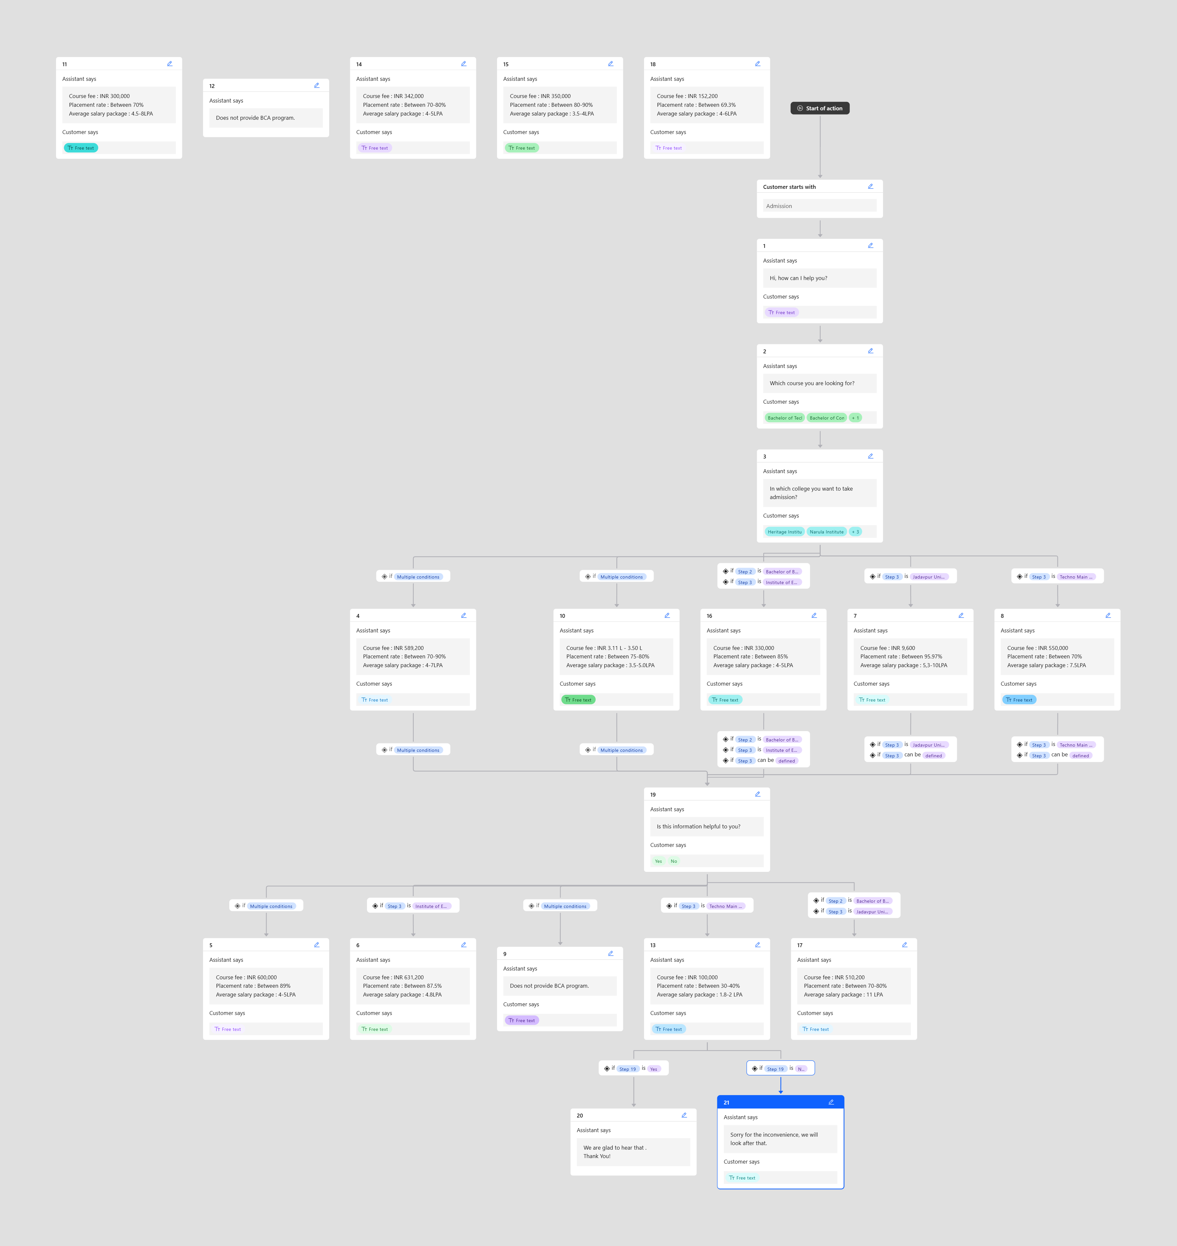
IBM cloud services used
Watsonx Assistant Service

Slide 6
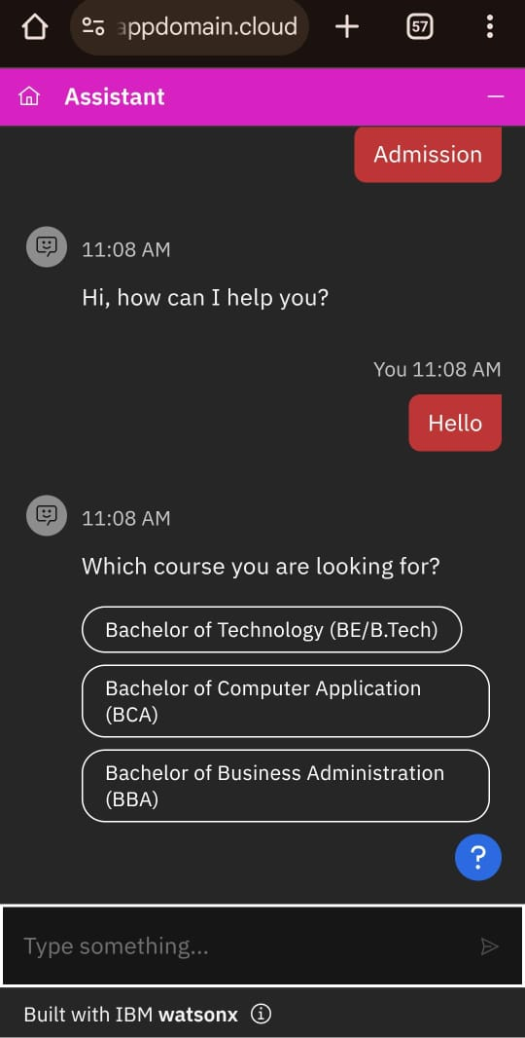
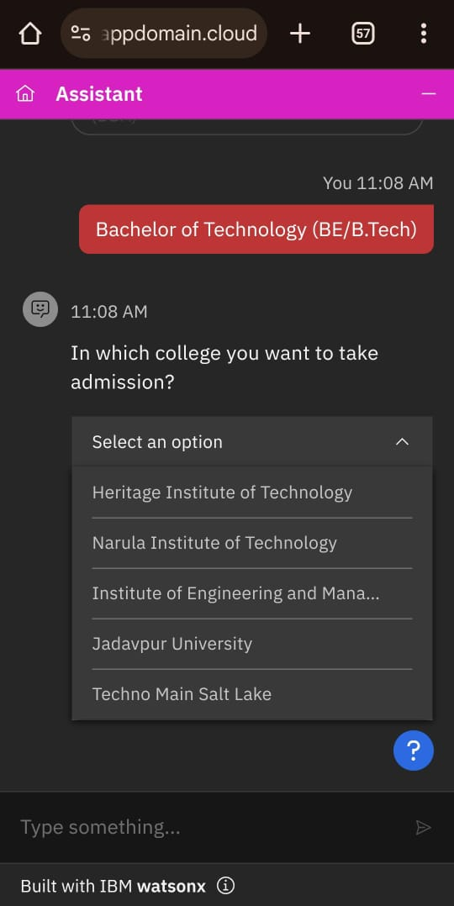
Wow factors
Wow!
You can now select the course and from which college you want to complete this course to know the basic information about the college.

Slide 7
End users
. Parents
. Students
. College Administrative Officers

Slide 8
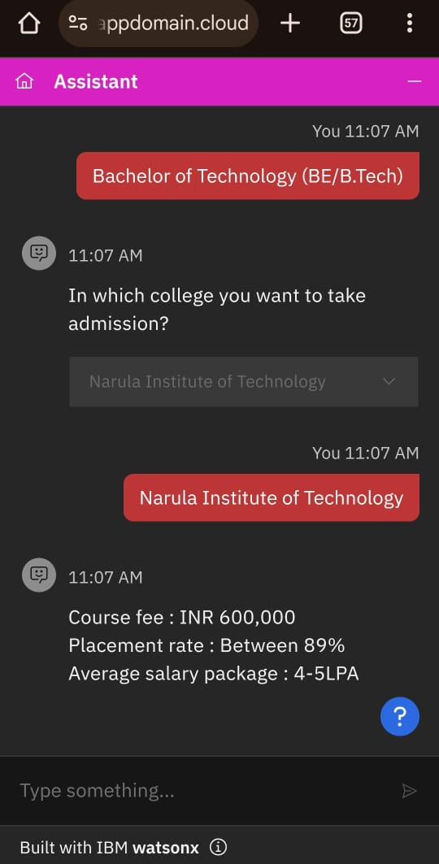
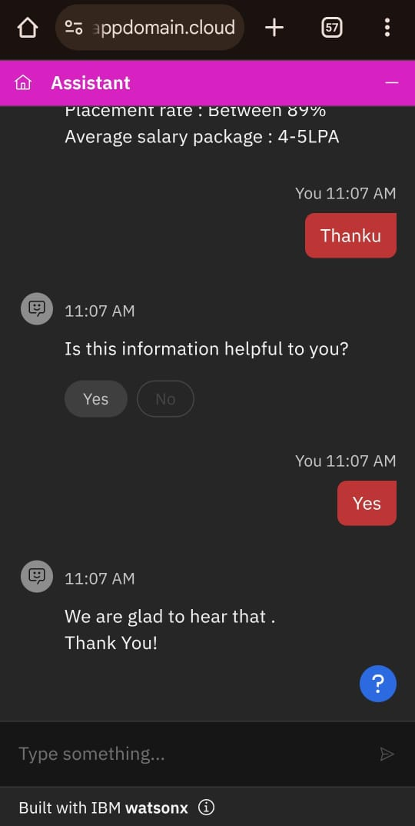
Results

Slide 9
Conclusion
This Educational Bot is solving the problem of students and parents about getting the information of any college. This is providing course fee structure , Placement rate and Average salary package of a different courses of a particular College . This helps them to save time during the process. They can easily compare between different colleges and select the best among them.

Slide 10
GitHub Link
https://github.com/Aakhya05/Chatbox-Project-

Slide 11
Future scope
24/7 Tutoring & Assistance
AI-Driven Personalization
Career & Placement Insight
Real-Time & Updated Data Integration
Multilingual & Voice Support

Slide 12
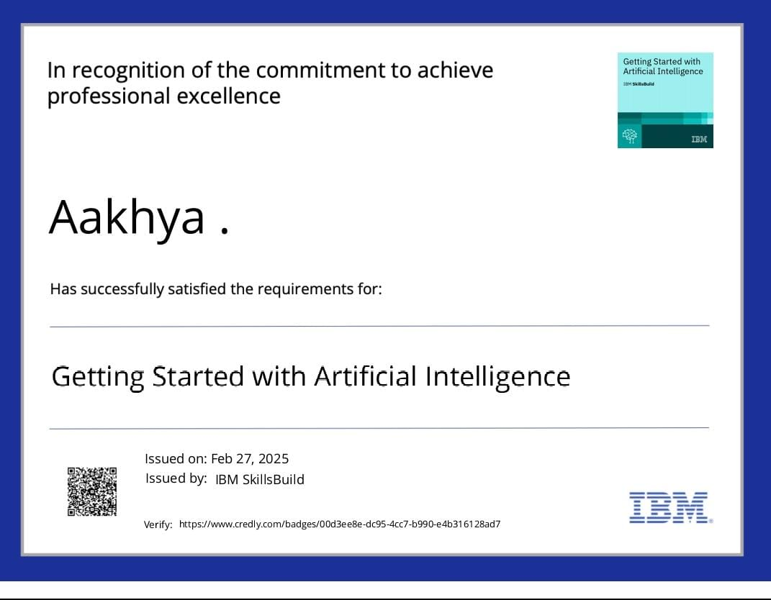
IBM Certifications

Slide 13
THANK YOU

